Slide 1
ARTIFICIAL INTELLIGENCE
5
Handayani Tjandrasa

Slide 2
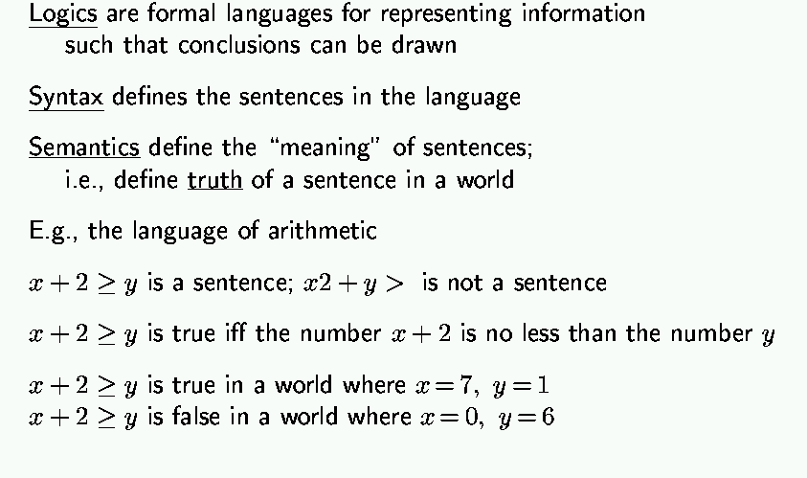
Logic in general

Slide 3
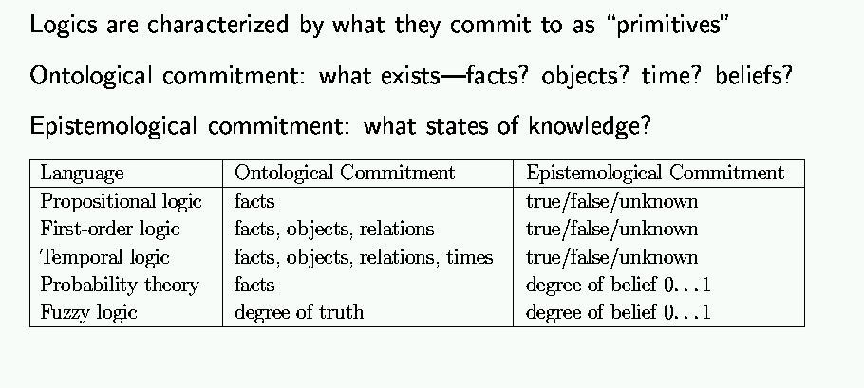
Types of logic

Slide 4
Basic symbols
Expressions only evaluate to either “true” or “false.”
P “P is true”
¬P “P is false” negation
P V Q “either P is true or Q is true or both” disjunction
P ^ Q “both P and Q are true” conjunction
P => Q “if P is true, the Q is true” implication
P ⬄ Q “P and Q are either both true or both false” biimplication

Slide 5
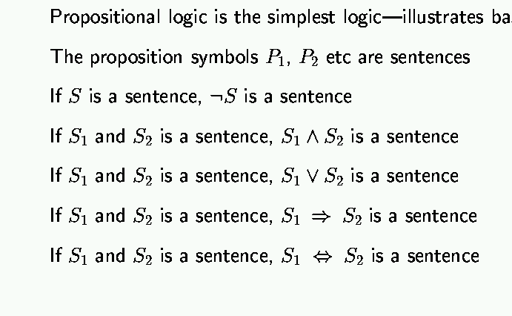
Propositional logic: syntax

Slide 6
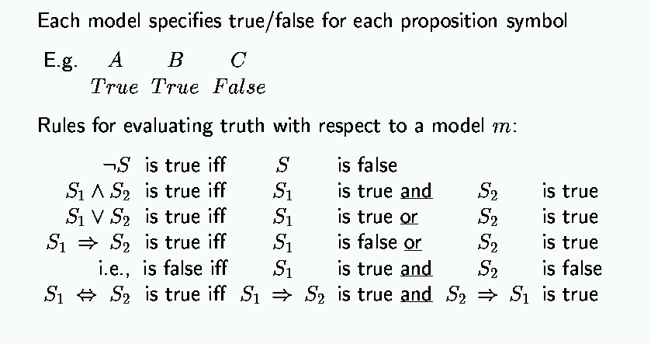
Propositional logic: semantics

Slide 7
Truth tables
Truth value: whether a statement is true or false.
Truth table: complete list of truth values for a statement given all possible values of the individual atomic expressions.
Example:
P Q P V Q
T T T
T F T
F T T
F F F

Slide 8
Truth tables for basic connectives
P Q ¬P ¬Q P V Q P ^ Q P=>Q P⬄Q
T T F F T T T T
T F F T T F F F
F T T F T F T F
F F T T F F T T

Slide 9
Propositional logic: basic manipulation rules
¬(¬A) = A Double negation
¬(A ^ B) = (¬A) V (¬B) Negated “and”
¬(A V B) = (¬A) ^ (¬B) Negated “or”
A ^ (B V C) = (A ^ B) V (A ^ C) Distributivity of ^ on V
A => B = (¬A) V B by definition
¬(A => B) = A ^ (¬B) using negated or
A ⬄ B = (A => B) ^ (B => A) by definition
¬(A ⬄ B) = (A ^ (¬B))V(B ^ (¬A)) using negated and & or
…

Slide 10
First-order logic (FOL)
Ontological commitments:
Objects: wheel, door, body, engine, seat, car, passenger, driver
Relations: Inside(car, passenger), Beside(driver, passenger)
Functions: ColorOf(car)
Properties: Color(car), IsOpen(door), IsOn(engine)
Functions are relations with single value for each object

Slide 11
Semantics
there is a correspondence between
functions, which return values
predicates, which are true or false
Function: father_of(Mary) = Bill
Predicate: father_of(Mary, Bill)
Notes:
more formally, this is how build interpretation of whole from interpretation of parts.
predicate and relation used interchangeably; here predicate is the formal symbol and relation the real world relation
give example of tuples for functions and relations (e.g. son-of, son)

Slide 12
FOL: Syntax of basic elements
Constant symbols: 1, 5, A, B, USC, JPL, Alex, Manos, …
Predicate symbols: >, Friend, Student, Colleague, …
Function symbols: +, sqrt, SchoolOf, TeacherOf, ClassOf, …
Variables: x, y, z, next, first, last, …
Connectives: ∧, ∨, ⇒, ⇔
Quantifiers: ∀, ∃
Equality: =

Slide 13
Syntax of Predicate Logic
Symbol set
constants
Boolean connectives
variables
functions
predicates (relations)
quantifiers
Notes:
ok so now we have to start at the beginning with the syntax
there are lots of kinds of logics, this is the touchstone: FOPL=FOPC=FOL
give examples of each of these, including of quantified expressions: put on board; be very careful NOT to say what mean. Just doing semantics.
Joe, table50; x, y; son-of, next-to; age, color, son
forall and there-exists
∀x likes(x, chocolate)
∃x eats(x,chocolate)
∀x ∃y eats(x,y) not same as ∃y ∀x eats(x,y) on(a,b)∧on(b,c)⇒on(a,c)
variables: we will deal with ONLY in the context of a quantifier that binds; as a result, we won’t have to worry about what the variable in isolation refers to.
terminology (write on board):
atomic sentence: relation plus args
literal: an atomic sentence (formula) or its negation
ground literal: no variables

Slide 14
Syntax of Predicate Logic
Terms: a reference to an object
variables,
constants,
functional expressions (can be arguments to predicates)
Examples:
first([a,b,c]), sq_root(9), sq_root(n), tail([a,b,c])
Notes:
ok so now we have to start at the beginning with the syntax
there are lots of kinds of logics, this is the touchstone: FOPL=FOPC=FOL
give examples of each of these, including of quantified expressions: put on board; be very careful NOT to say what mean. Just doing semantics.
Joe, table50; x, y; son-of, next-to; age, color, son
forall and there-exists
∀x likes(x, chocolate)
∃x eats(x,chocolate)
∀x ∃y eats(x,y) not same as ∃y ∀x eats(x,y) on(a,b)∧on(b,c)⇒on(a,c)
variables: we will deal with ONLY in the context of a quantifier that binds; as a result, we won’t have to worry about what the variable in isolation refers to.
terminology (write on board):
atomic sentence: relation plus args
literal: an atomic sentence (formula) or its negation
ground literal: no variables

Slide 15
Syntax of Predicate Logic
Sentences: make claims about objects
(Well-formed formulas, (wffs))
Atomic Sentences (predicate expressions):
loves(John,Mary), brother_of(John,Ted)
Complex Sentences (Atomic Sentences connected by booleans):
loves(John,Mary)
brother_of(John,Ted)
teases(Ted, John)
Notes:
ok so now we have to start at the beginning with the syntax
there are lots of kinds of logics, this is the touchstone: FOPL=FOPC=FOL
give examples of each of these, including of quantified expressions: put on board; be very careful NOT to say what mean. Just doing semantics.
Joe, table50; x, y; son-of, next-to; age, color, son
forall and there-exists
∀x likes(x, chocolate)
∃x eats(x,chocolate)
∀x ∃y eats(x,y) not same as ∃y ∀x eats(x,y) on(a,b)∧on(b,c)⇒on(a,c)
variables: we will deal with ONLY in the context of a quantifier that binds; as a result, we won’t have to worry about what the variable in isolation refers to.
terminology (write on board):
atomic sentence: relation plus args
literal: an atomic sentence (formula) or its negation
ground literal: no variables

Slide 16
Examples of Terms: Constants, Variables and Functions
Constants: object constants refer to individuals
Alan, Sam, R225, R216
Variables
PersonX, PersonY, RoomS, RoomT
Functions
father_of(PersonX)
product_of(Number1,Number2)

Slide 17
Examples of Predicates and Quantifiers
Predicates
in(Alan,R225)
partOf(R225,Pender)
fatherOf(PersonX,PersonY)
Quantifiers
All dogs are mammals.
Some birds can’t fly.
3 birds can’t fly.

Slide 18
Semantics
Referring to individuals
Jackie
son-of(Jackie), Sam
Referring to states of the world
person(Jackie), female(Jackie)
mother(Sam, Jackie)
Notes:
important to recognize the syntactic difference between functions and predicates, and the corresponding semantic difference

Slide 19
FOL: Atomic sentences
AtomicSentence → Predicate(Term, …) | Term = Term
Term → Function(Term, …) | Constant | Variable
Examples:
SchoolOf(Manos)
Colleague(TeacherOf(Alex), TeacherOf(Manos))
>((+ x y), x)

Slide 20
FOL: Complex sentences
Sentence → AtomicSentence | Sentence Connective Sentence | Quantifier Variable, … Sentence | ¬ Sentence | (Sentence)
Examples:
S1 ∧ S2, S1 ∨ S2, (S1 ∧ S2) ∨ S3, S1 ⇒ S2, S1⇔ S3
Colleague(Paolo, Maja) ⇒ Colleague(Maja, Paolo) Student(Alex, Paolo) ⇒ Teacher(Paolo, Alex)

Slide 21
Semantics of atomic sentences
Sentences in FOL are interpreted with respect to a model
Model contains objects and relations among them
Terms: refer to objects (e.g., Door, Alex, StudentOf(Paolo))
Constant symbols: refer to objects
Predicate symbols: refer to relations
Function symbols: refer to functional Relations
An atomic sentence predicate(term₁, …, term_{n}) is true iff the relation referred to by predicate holds between the objects referred to by term₁, …, term_{n}

Slide 22
Example model
Objects: John, James, Marry, Alex, Dan, Joe, Anne, Rich
Relation: sets of tuples of objects {<John, James>, <Marry, Alex>, <Marry, James>, …} {<Dan, Joe>, <Anne, Marry>, <Marry, Joe>, …}
E.g.: Parent relation -- {<John, James>, <Marry, Alex>, <Marry, James>} then Parent(John, James) is true Parent(John, Marry) is false

Slide 23
Quantifiers
Expressing sentences about collections of objects without enumeration (naming individuals)
E.g., All Trojans are clever Someone in the class is sleeping
Universal quantification (for all): ∀
Existential quantification (there exists): ∃

Slide 24
Universal quantification (for all): ∀
∀ <variables> <sentence>
“Every one in the cs561 class is smart”: ∀ x In(cs561, x) ⇒ Smart(x)
∀ P corresponds to the conjunction of instantiations of P In(cs561, Manos) ⇒ Smart(Manos) ∧ In(cs561, Dan) ⇒ Smart(Dan) ∧ … In(cs561, Clinton) ⇒ Smart(Clinton)

Slide 25
Universal quantification (for all): ∀
⇒ is a natural connective to use with ∀
Common mistake: to use ∧ in conjunction with ∀ e.g: ∀ x In(cs561, x) ∧ Smart(x) means “every one is in cs561 and everyone is smart”

Slide 26
Existential quantification (there exists): ∃
∃ <variables> <sentence>
“Someone in the cs561 class is smart”: ∃ x In(cs561, x) ∧ Smart(x)
∃ P corresponds to the disjunction of instantiations of P In(cs561, Manos) ∧ Smart(Manos) ∨ In(cs561, Dan) ∧ Smart(Dan) ∨ … In(cs561, Clinton) ∧ Smart(Clinton)

Slide 27
Existential quantification (there exists): ∃
∧ is a natural connective to use with ∃
Common mistake: to use ⇒ in conjunction with ∃ e.g: ∃ x In(cs561, x) ⇒ Smart(x) is true if there is anyone that is not in cs561!
(remember, false ⇒ true is valid).

Slide 28
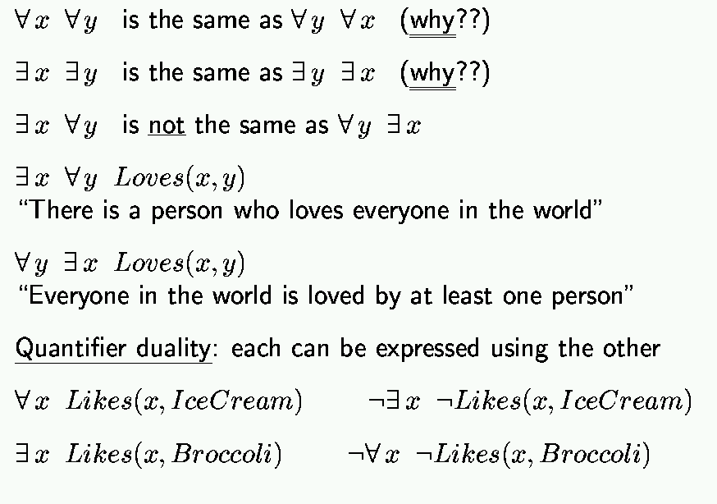
Properties of quantifiers
Not all by one person but each one at least by one
Proof?

Slide 29
Proof
In general we want to prove:
∀ x P(x) <=> ¬ ∃ x ¬ P(x)
∀ x P(x) = ¬(¬(∀ x P(x))) = ¬(¬(P(x1) ^ P(x2) ^ … ^ P(xn)) ) = ¬(¬P(x1) v ¬P(x2) v … v ¬P(xn)) )
∃ x ¬P(x) = ¬P(x1) v ¬P(x2) v … v ¬P(xn)
¬∃ x ¬P(x) = ¬(¬P(x1) v ¬P(x2) v … v ¬P(xn))

Slide 30
Example sentences
Brothers are siblings .
Sibling is transitive .
One’s mother is one’s sibling’s mother .
A first cousin is a child of a parent’s sibling .

Slide 31
Example sentences
Brothers are siblings ∀ x, y Brother(x, y) ⇒ Sibling(x, y)
Sibling is transitive ∀ x, y, z Sibling(x, y) ∧ Sibling(y, z) ⇒ Sibling(x, z)
One’s mother is one’s sibling’s mother ∀ m, c Mother(m, c) ∧ Sibling(c, d) ⇒ Mother(m, d)
A first cousin is a child of a parent’s sibling ∀ c, d FirstCousin(c, d) ⇔ ∃ p, ps Parent(p, d) ∧ Sibling(p, ps) ∧ Parent(ps, c)

Slide 32
Example sentences
One’s mother is one’s sibling’s mother ∀ m, c,d Mother(m, c) ∧ Sibling(c, d) ⇒ Mother(m, d)
∀ c,d ∃m Mother(m, c) ∧ Sibling(c, d) ⇒ Mother(m, d)
m
c
Mother of
d
sibling

Slide 33
Translating English to FOL
Every gardener likes the sun.
∀ x gardener(x) => likes(x,Sun)
You can fool some of the people all of the time.
∃ x ∀ t (person(x) ^ time(t)) => can-fool(x,t)

Slide 34
Translating English to FOL
You can fool all of the people some of the time.
∀ x ∃ t (person(x) ^ time(t) =>
can-fool(x,t)
All purple mushrooms are poisonous.
∀ x (mushroom(x) ^ purple(x)) => poisonous(x)

Slide 35
Translating English to FOL…
No purple mushroom is poisonous.
¬(∃ x) purple(x) ^ mushroom(x) ^ poisonous(x)
or, equivalently,
(∀ x) (mushroom(x) ^ purple(x)) => ¬poisonous(x)

Slide 36
Translating English to FOL…
There are exactly two purple mushrooms.
(∃ x)(∃ y) mushroom(x) ^ purple(x) ^ mushroom(y) ^ purple(y) ^ ¬(x=y) ^ (∀ z) (mushroom(z) ^ purple(z)) => ((x=z) v (y=z))
Deb is not tall.
¬tall(Deb)

Slide 37
Translating English to FOL…
X is above Y if X is on directly on top of Y or else there is a pile of one or more other objects directly on top of one another starting with X and ending with Y.
(∀ x)(∀ y) above(x,y) <=> (on(x,y) v (∃ z) (on(x,z) ^ above(z,y)))

Slide 38
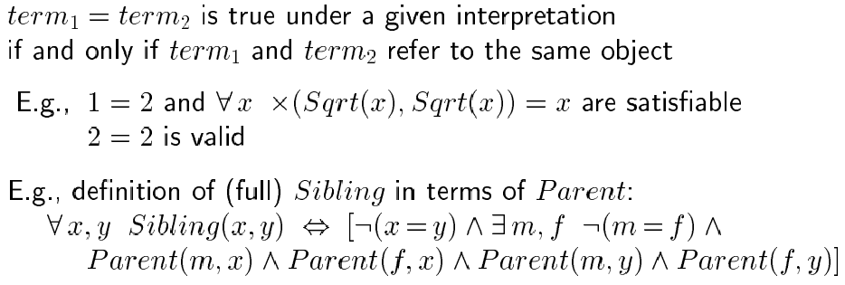
Equality

Slide 39
Higher-order logic?
First-order logic allows us to quantify over objects (= the first-order entities that exist in the world).
Higher-order logic also allows quantification over relations and functions.
e.g., “two objects are equal iff all properties applied to them are equivalent”:
∀ x,y (x=y) ⇔ (∀ p, p(x) ⇔ p(y))
Higher-order logics are more expressive than first-order; however, so far we have little understanding on how to effectively reason with sentences in higher-order logic.

Slide 40
Knowledge-based Systems: Rule-based Knowledge Systems (Expert Systems)
Chapter 7 – Patrick H. Winston

Slide 41
Rule-based systems:
Overview:
Deductive versus Reactive rule-systems
“Zookeeper”: a deductive rule-system
“Bagger”: a reactive rule-system
Procedures for inference in Rule-systems
Explanation facilities

Slide 42
Deductive Rule-Systems:
Consist of rules of the form:
If Condition_1
and Condition_2
…
and Condition_n
Then Conclusion_1
and Conclusion_2
…
and Conclusion_m
Winston’s notation:
Know
facts
Deduced
facts
AND gate

Slide 43
Basics for Deduction Systems:
true
true
assertions
facts
false
The working memory =
a collection of assertions
Can be either facts or hypothesis:
In FORWARD chaining, we usually start from facts and add
assertions that are new facts:
Know
facts
Deduced
facts
In BACKWARD chaining, we usually start from hypothesis and add assertions that are new hypothesis.
New
hypothesis
Hypothesis

Slide 44
ZOOKEEPER:
Winston’s simplification of MYCIN.
Robby robot attempts to identify animals in the ZOO.
Z1 If ?x has hair
Then ?x is a mammal
Z2 If ?x gives milk
Then ?x is a mammal
Z3 If ?x has feathers
Then ?x is a bird
Z4 If ?x flies and ?x lays eggs
Then ?x is a bird
Z5 If ?x is a mammal and ?x eats meat
Then ?x is a carnivore

Slide 45
ZOOKEEPER (cont.):
Z6 If ?x is a mammal and ?x has pointed teeth
and ?x has claws and ?x has forward-pointed eyes
Then ?x is a carnivore
Z7 If ?x is a mammal and ?x has hoofs
Then ?x is an ungulate
Z8 If ?x is a mammal and ?x chews cud
Then ?x is an ungulate
Z9 If ?x is a carnivore and ?x has tawny color
and ?x has dark spots
Then ?x is a cheetah
Z10 If ?x is a carnivore and ?x has tawny color
and ?x has black stripes
Then ?x is a tiger

Slide 46
ZOOKEEPER (cont.2):
Z11 If ?x is an ungulate and ?x has long legs
and ?x has long neck and ?x has dark spots
Then ?x is a giraffe
Z12 If ?x is an ungulate and ?x has white color
and ?x has black stripes
Then ?x is a zebra
Z13 If ?x is an bird and ?x does not fly
and ?x has long legs and ?x has long neck
Then ?x is an ostrich
Z14 If ?x is an bird and ?x does not fly
and ?x swims and ?x is black and white
Then ?x is a penguin

Slide 47
Forward chaining in Zookeeper:
Working
memory
Stretch has hair.
Stretch chews cud.
Stretch has long legs.
Stretch has a long neck.
Stretch has dark spots.
First rule fires
Has
hair
Z1
Is a mammal
Second rule fires
Chews cud
Z8
Is an ungulate
Has long legs
Third rule fires
Has a long neck
Z11
Is a giraffe
Has dark spots

Slide 48
Backward chaining in Zookeeper
Knowledge
base
Swifty has forward-pointing eyes.
Swifty has pointed teeth.
Swifty has tawny color.
Swifty has claws.
Swifty has dark spots.
Swifty has hair.
Working memory
Swifty is a cheetah.
Has forward-pointing eyes
Third rule
Has claws
Z6
Is a carnivore
Has pointed teeth
Fourth rule
Has hair
Z1
Is a mammal
Second rule tried
Eats meat
Z5
Is a carnivore
First rule used
Has a tawny color
Z9
Has dark spots
Is a cheetah

Slide 49
Old backward/forward choice:
Mostly: the branching factor argument.
Winston terminology: “fan out”, “fan in”
Also:
Are you able to gather more facts?
If not: just forward chain to see what you can get as conclusions
If you are only interested in a specific question:
Is it a carnivore?
Backward better

Slide 50
Example: Mycin
- Diagnoses Bacterial Infections of the blood.
How to choose antibiotic treatment, without knowing
exactly which organism?
- Preferably: don’t prescribe a broad-spectrum drug
- Narrow down to more specific, using information
concerning:
patient symptoms, general condition,
quick lab-tests, ...
- Questions and advises physician.

Slide 51
Excerpt of sample session:
> Male or female?
Male.
> Age?
55.
> Have you obtained positive cultures indicating general type?
Yes.
> What type of infection is it?
Primary bacteremia.
> When did symptoms first appear?
May 5.
> From where was the positive culture taken?
From the blood.
> …

Slide 52
Mycin (cont.)
About 500 If-Then rules .
Can recognize about 100 causes of infections.
Example rule:
If ?x ’s type is primary bacteremia
the suspected entry point of ?x is the gastrointestinal tract
the site of the culture of ?x is one of the sterile sites
Then there is evidence that ?x is bacteroides
Uses: backward chaining.
… and certainty factors.

Slide 53
Query-the-user facility:
Where do the questions come from?
> Age?
55.
The query-the-user rule:
Any system includes a rule of the type
If query-the-user( ?x )
Then ?x
Here ?x could be any predicate
If we want to establish ?x and there is no information on ?x in the rule-base, ask the user about ?x
If age_patient(?x)
?x > 50
Then ...
No “age_patient(..)”
in rule-base
query-the-user(
age_patient(?x))

Slide 54
Reactive Rule-Systems:
Consist of rules of the form:
If Condition_1
and Condition_2
…
and Condition_n
Then Action_1
and Action_2
…
and Action_m
No more relation to logical statements !

Slide 55
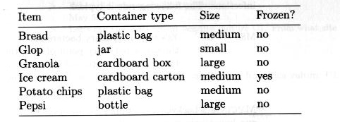
BAGGER:
Winston’s simplification of XCON.
Robby robot attempts to help bagging in a supermarket.
It considers 4 steps in the procedure:
1. ”check order” :see if something is missing
2. ”bag the large items” and put big bottles in first
3. “bag medium items” and put frozen things in freezer bags
4. “bag small items” : put wherever there is room
Use a
database
of objects

Slide 56
Bagger’s Working Memory:
Current step is “Check order”
Current bag is Bag_1(empty)
Not bagged are bread, glop, granola (2), ice cream, patato chips
+ the database of objects

Slide 57
Bagger rules:
B1 If step is “check order”
and potato chips are in not bagged
and Pepsi is NOT in not bagged
Then suggest to add Pepsi to not bagged
Assume suggestion is accepted and Pepsi added in not bagged.
B2 If step is “check order”
Then discontinue step “check order”
And start step “bag large items”
Note: whenever B1 is triggered, B2 is triggered as well !
Need: CONFLICT RESOLUTION

Slide 58
Conflict Resolution:
A rule in a rule-based system is triggered if the precondition of the rule is satisfied
A rule is said to fire
if its then-part is executed
In a deductive system, every triggered rule fires.
In a reactive system, we need a “conflict resolution strategy” to determine which rule may fire.
Assume for now that we use textual order here.

Slide 59
Bagger (cont.):
Working memory
Current step is “bag the large items”
Current bag is Bag_1(empty)
Not bagged are bread, glop, granola (2), ice cream, patato chips, Pepsi
B3 If step is “bag the large items”
and a large item is in not bagged
and a large bottle is in not bagged
and current bag has < 6 large items
Then put large bottle in current bag
B4 If step is “bag the large items”
and a large item is in not bagged
and current bag has < 6 large items
Then put large item in current bag
B5 If step is “bag the large items”
and a large item is in not bagged
Then start a fresh bag

Slide 60
Possible conflict resolution strategies:
Specificity ordering: highest priority rule has superset of conditions
Textual rule ordering (see Bagger)
Data ordering give a priority number to each possible aspect
Size ordering highest priority rule has largest list of conditions
Context limiting put rules into groups: activate/deactivate the groups

Slide 61
Example: XCON
- System for Configuration of Computer Systems.
How to set up all components of a big main frame
computer system.
- Includes processors, memory, terminals, discs,
peripheral controllers, etc.
- All components must be arranged sensibly with
appropriate input/output buses.
- Must deal with hundreds of possible options: how
to configure?

Slide 62
XCON (cont.)
About 10000 If-Then rules .
Can deal with about 200 components of VAX systems.
Example rules:
If context is doing layout and assigning power supply
an sbi module has been put in a cabinet
the position the sbi module occupies is known
there is space available for a power supply
there is no available power supply
the voltage and frequency of components is known
Then add an appropriate power supply
Similar to the Pepsi rule in bagger
If context is doing layout and assigning power supply
an sbi module has been put in a cabinet
the position the sbi module occupies is known
there is space available for a power supply
there is an available power supply
Then put the power supply in the cabinet in the available space

Slide 63
Explicit procedures for Back/Forward reasoning:
Depth-first search Even for forward reasoning!
Database operation (Join - Projection - Selection) for Forward Reasoning
Tuple-at-a-time database operations: the Rete algorithm
Ref: Winston for details.

Slide 64
Mixing Forward and Backward Reasoning:
Many commercial systems promote their ability to provide
both forward and backward reasoning (together) on the
same set of rules.
Is this useful? Or even reasonable??
- Forward reasoning starts from facts and produces new
fact.
Why would one want to start backward reasoning:
from hypothesis building new hypothesis from a fact??
- Backward reasoning starts from hypothesis and builds
new hypothesis.
These are not facts and cannot be used to derive new
fact from them in a forward reasoning !!

Slide 65
One way to combine forward and backward:
Assume that by forward reasoning we derived:
the facts a, b and d.
If there is a rule:
If a and b and c and d
Then e
then it may be a good idea to switch to backward reasoning to try to prove c (and thus conclude e)
BUT: VERY hard to control this and completeness becomes VERY obscure.

Slide 66
Explanation facilities:
Expert Systems are supposed to provide explanations to
convince the user that their proposed conclusions are
reasonable.
Typical user questions:
How did you arrive to the conclusion that … .
Why did you show that … .
Technique:
Keep a trace of all inferences done:
If a and b and c and d
Then e
And record e <- a, b, c, d

Slide 67
All these systems require FULL knowledge of the world !
What if information is Missing?
Information is Unclear?
Information is Vague?
Information is Contradicting?
Information Only probabilistically available?
Requires a study in Uncertainty, Fuzziness, ….

Slide 68
TERIMA KASIH

